Slide 1

Clean Code & SOLID & Refactoring TRAINING
Notes:
Trendyol Presentation Template & Slides için link
L&D Training Slide Template’i kullanarak slidelarımızı oluşturalım :)

Slide 2



AGENDA
1
What is Clean Code?
2
Meaningful Names
3
Functions
4
Comments
5
Unit Tests
6
SOLID
7
Refactoring

Slide 3

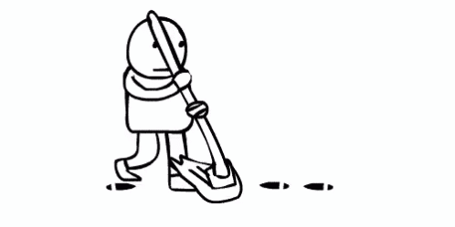

c
You are a programmer
You want to be a better programmer

Slide 4
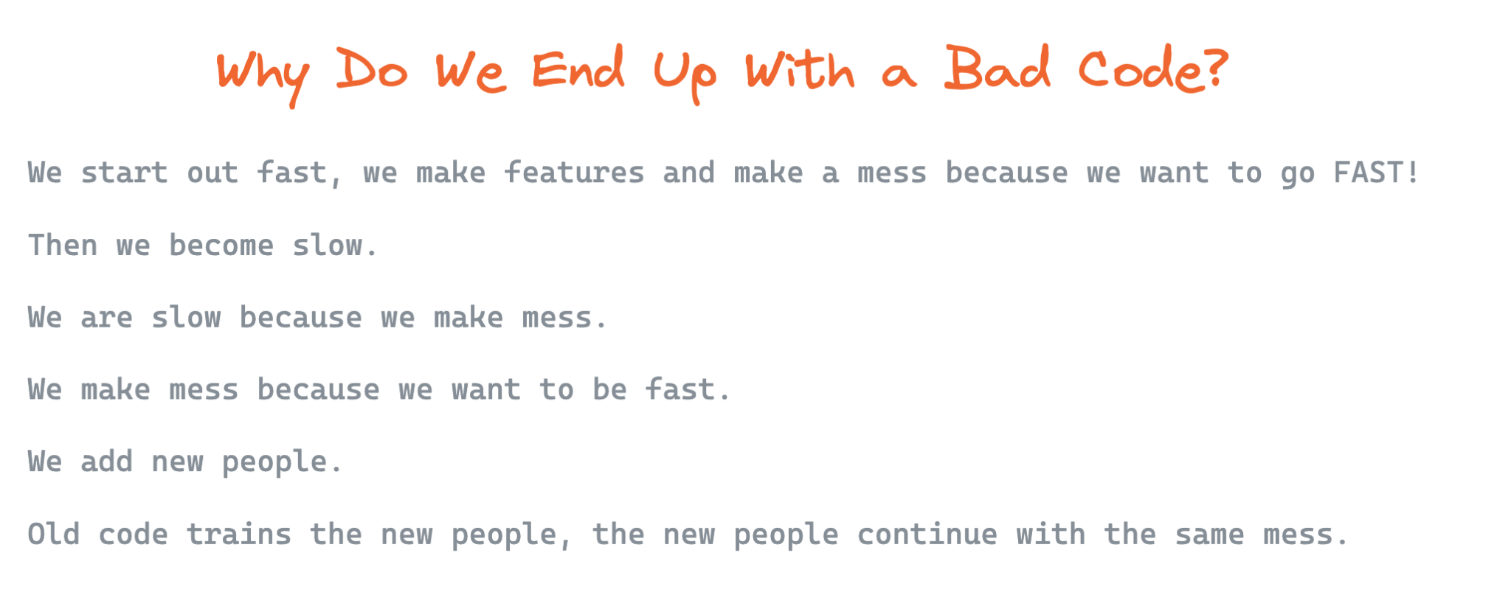

c

Slide 5
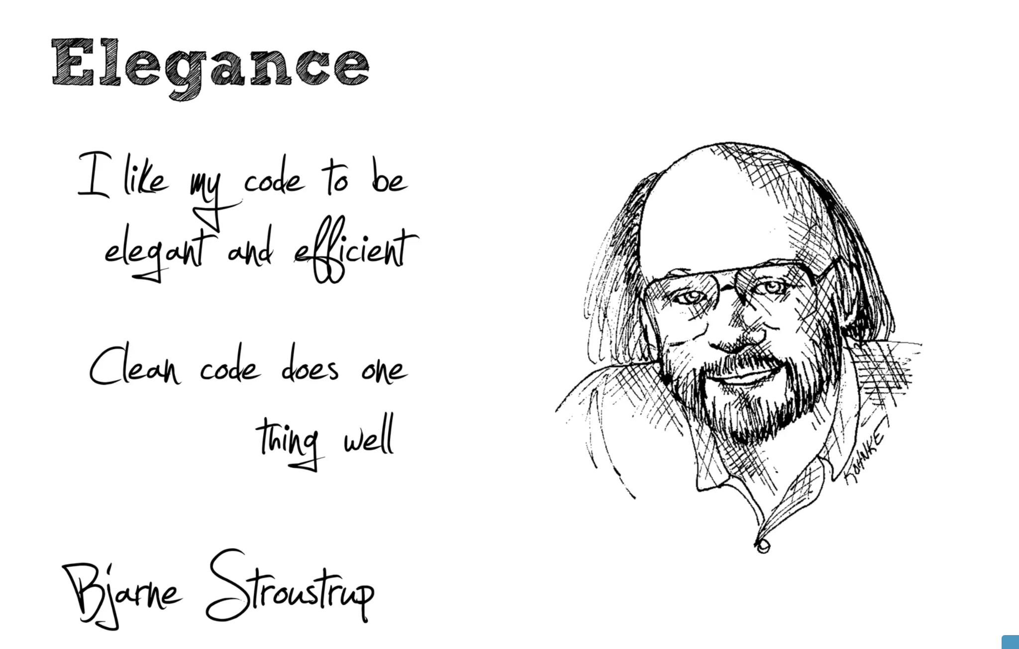

Slide 6
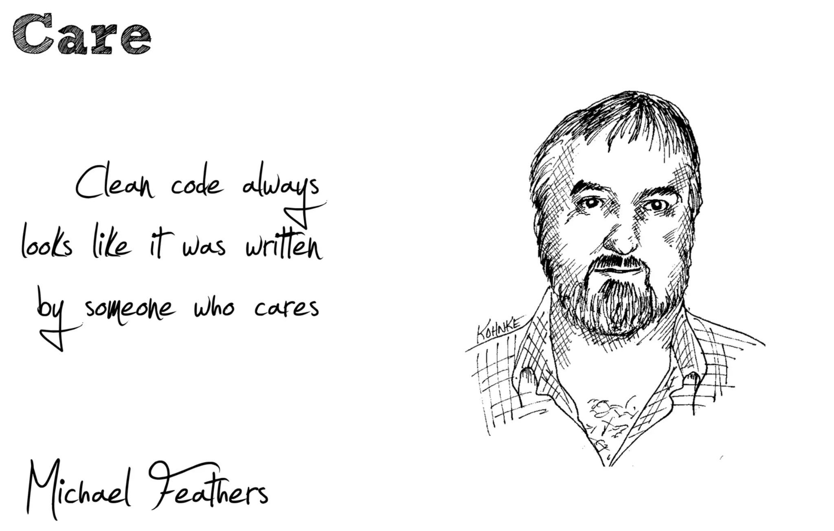

Slide 7
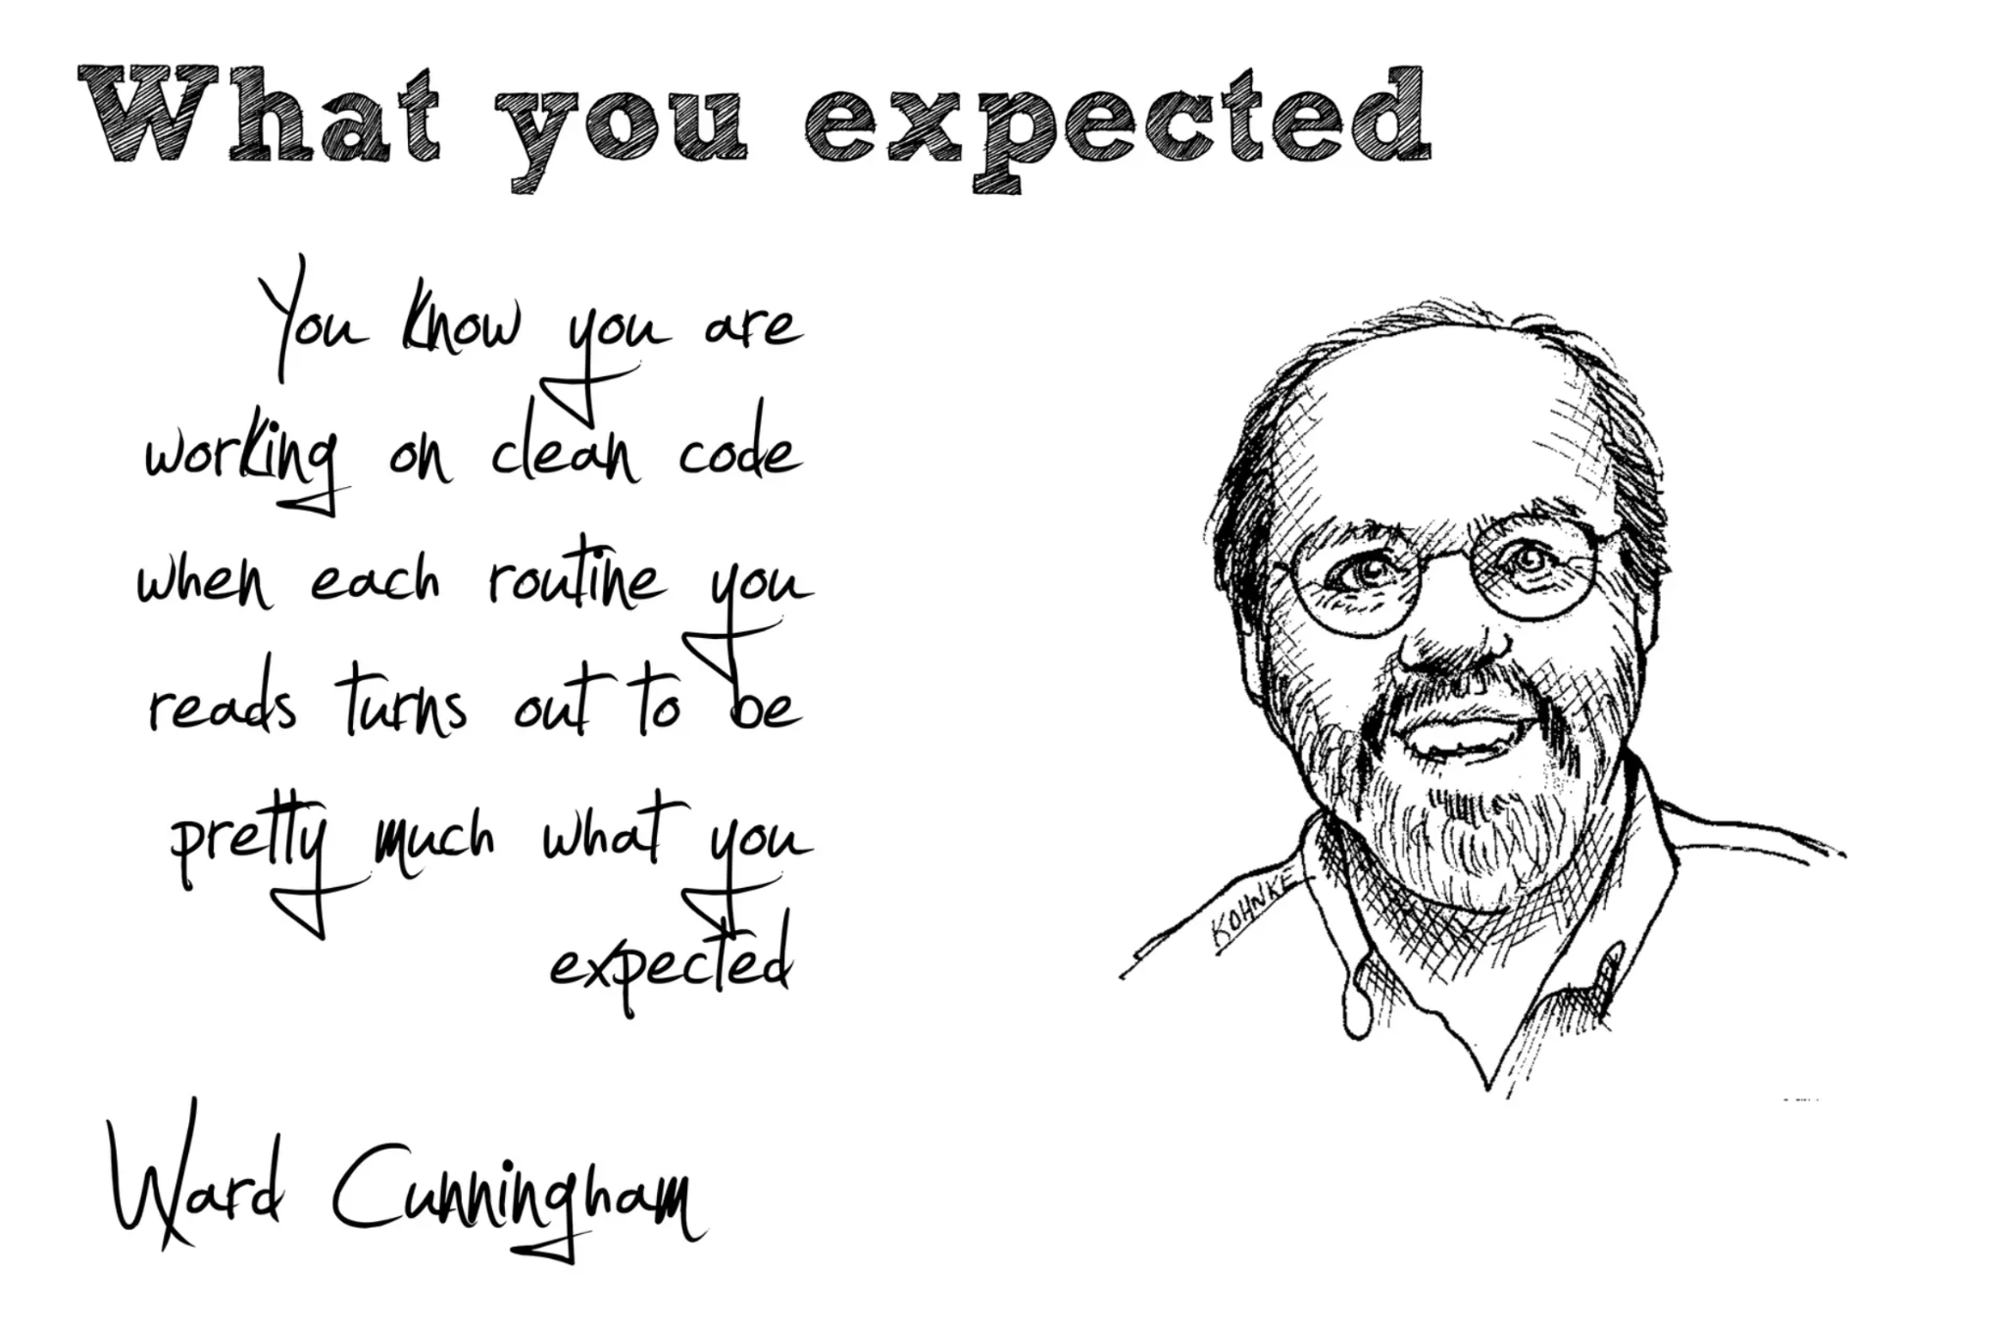

Slide 8
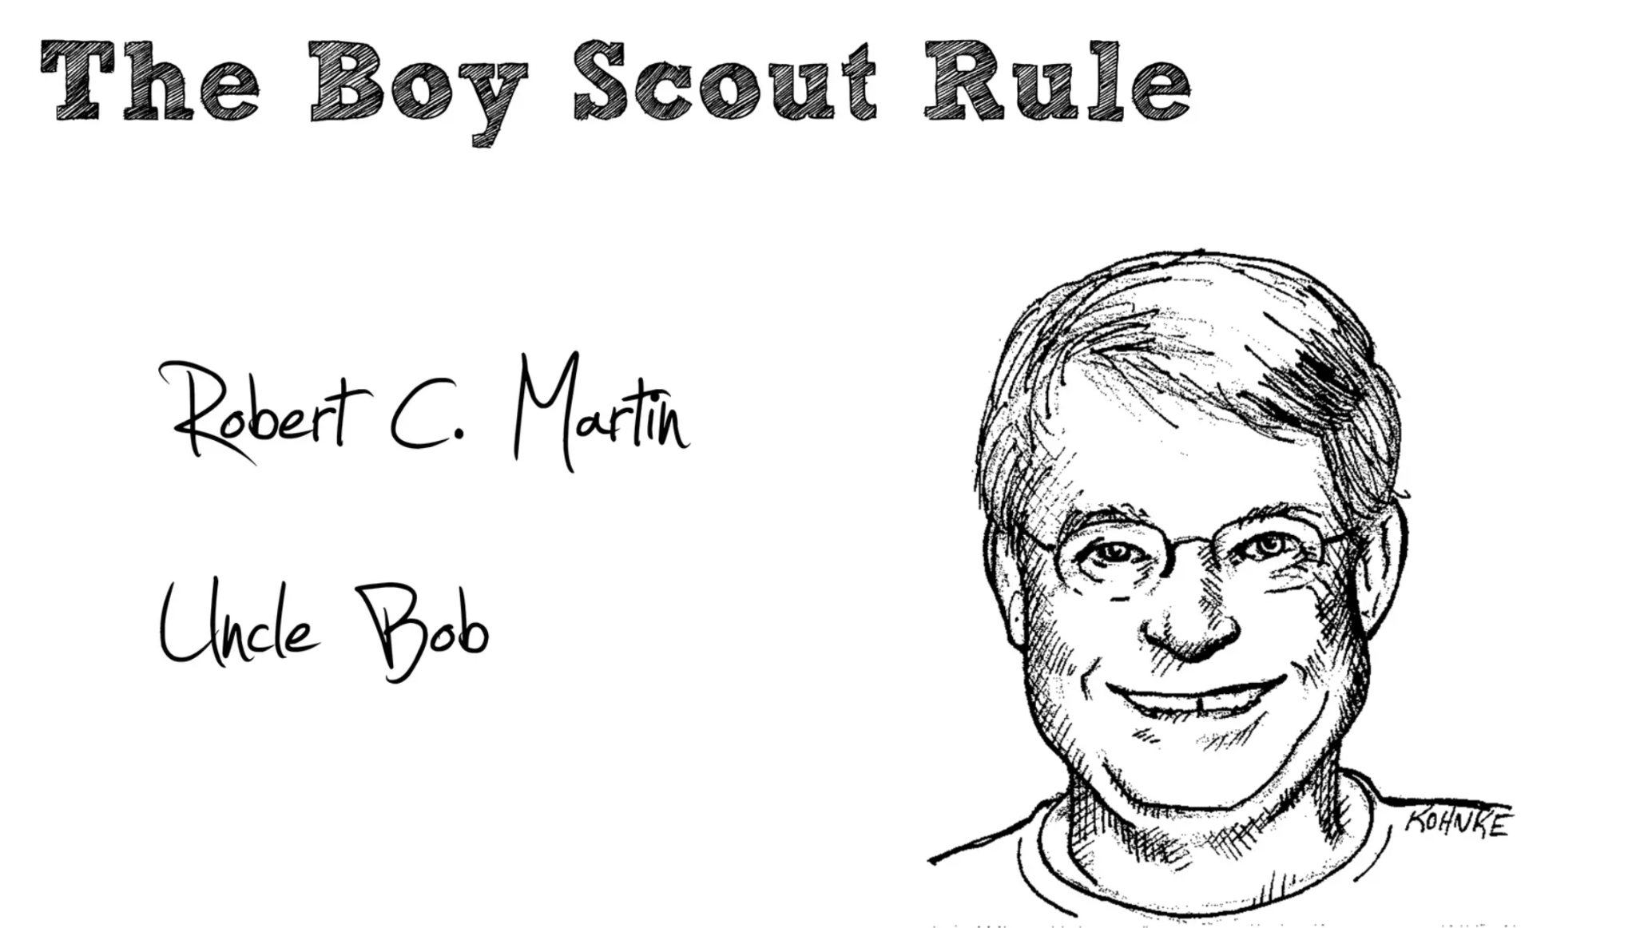

Slide 9
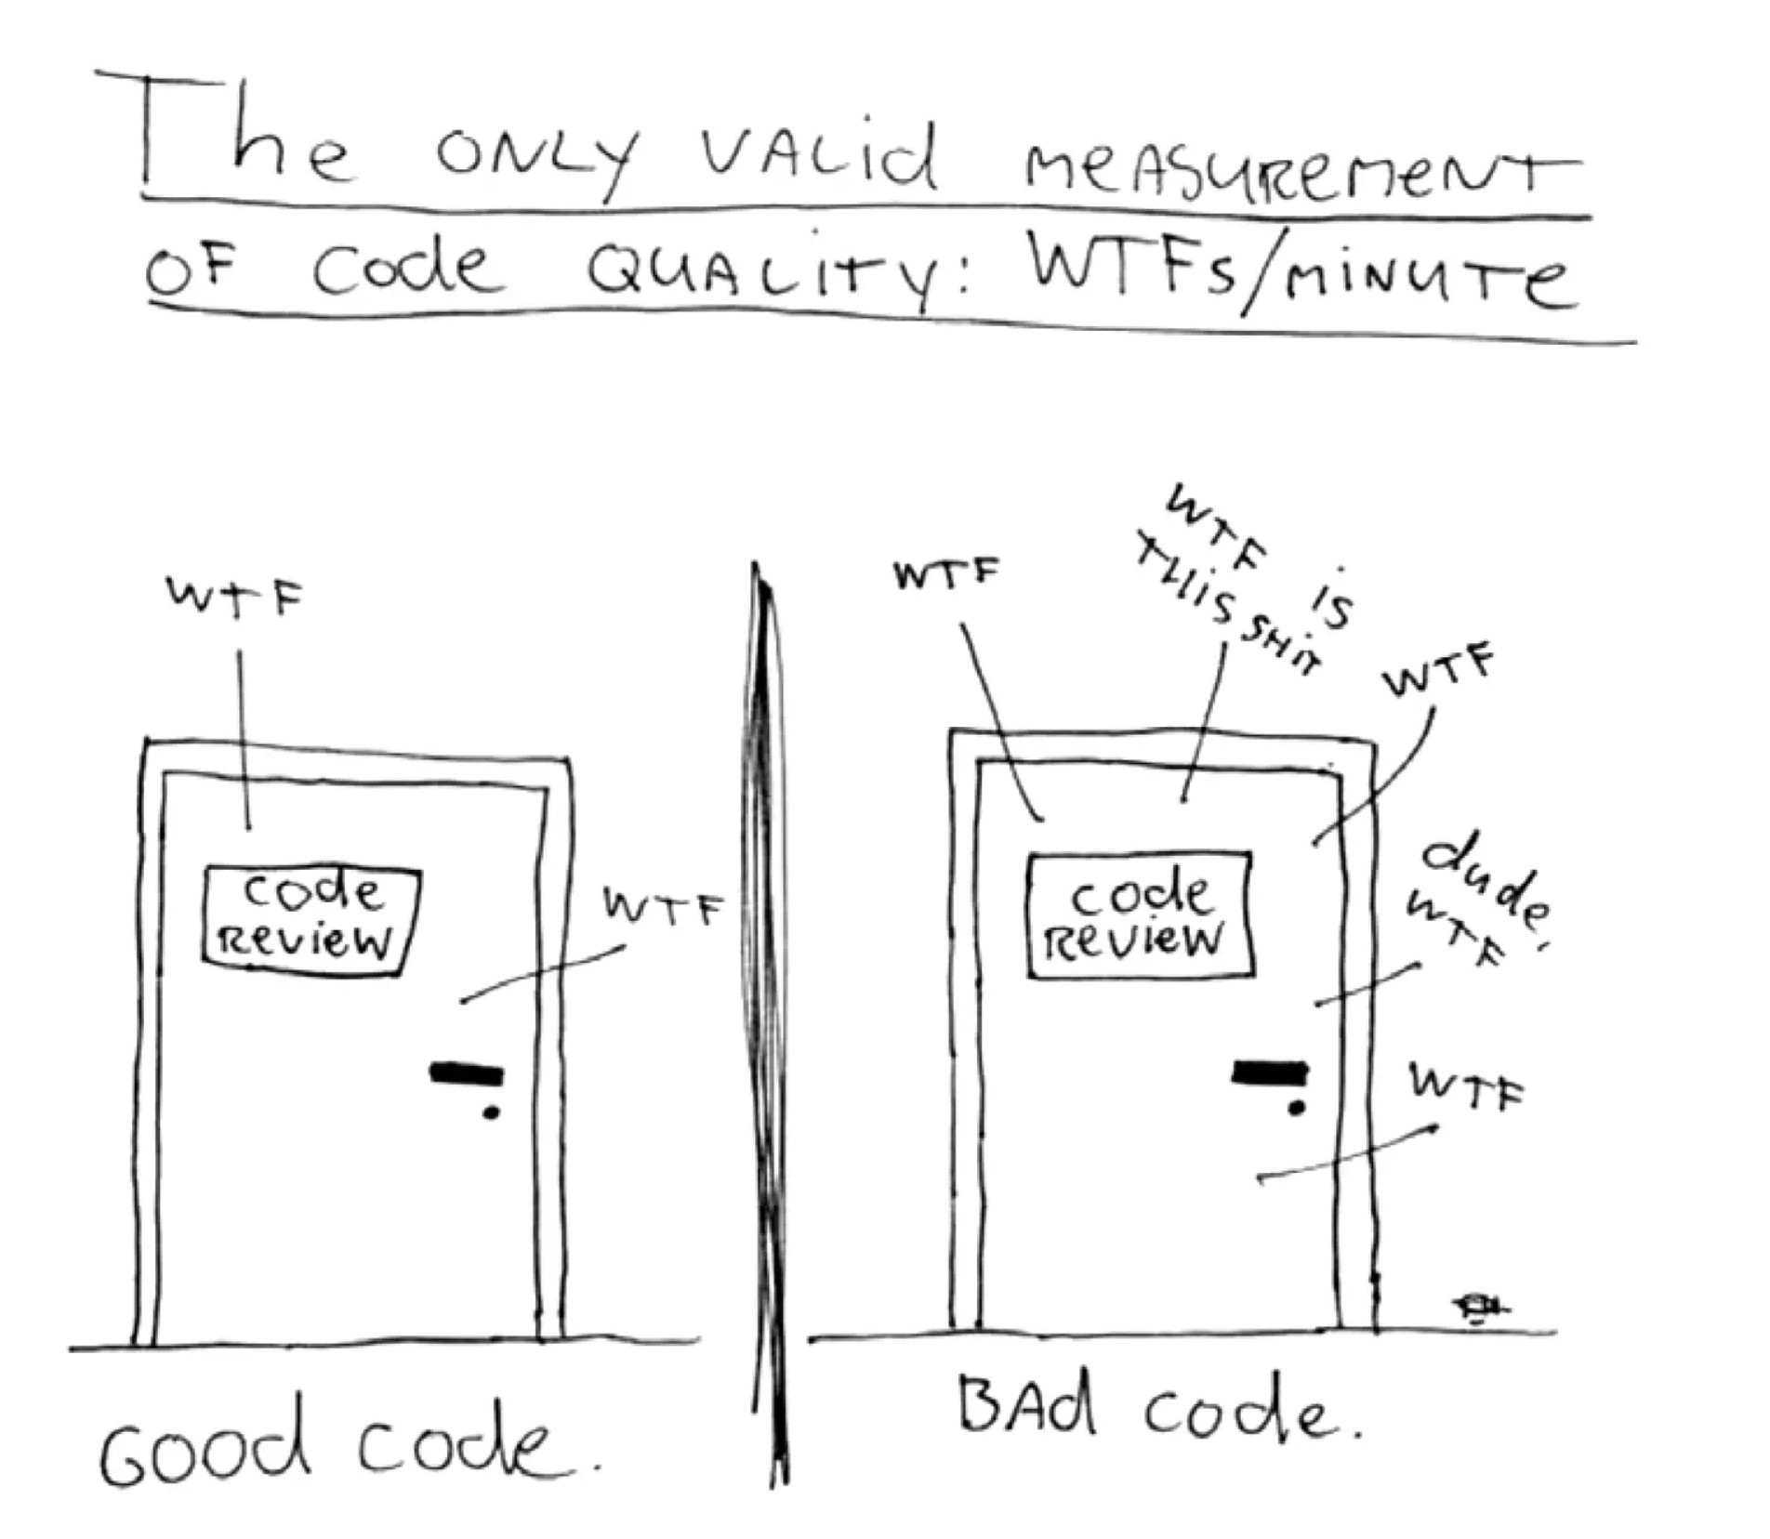

Slide 10
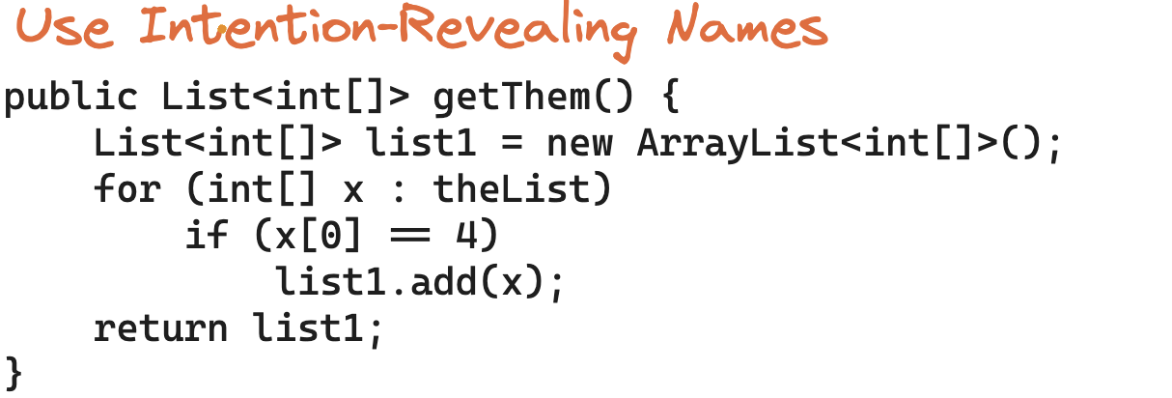
MEANINGFUL NAMES

Slide 11
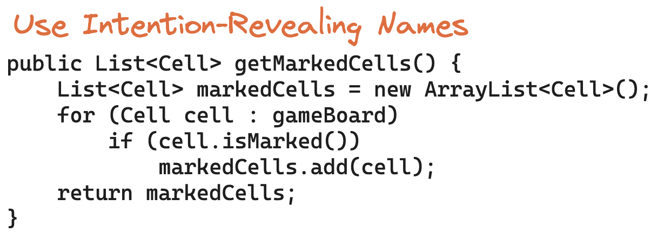
MEANINGFUL NAMES

Slide 12
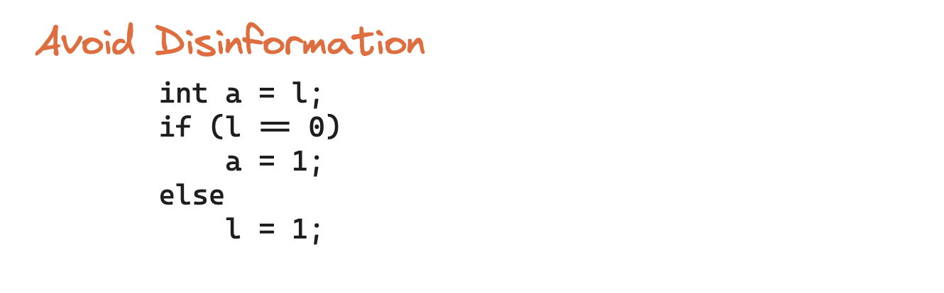
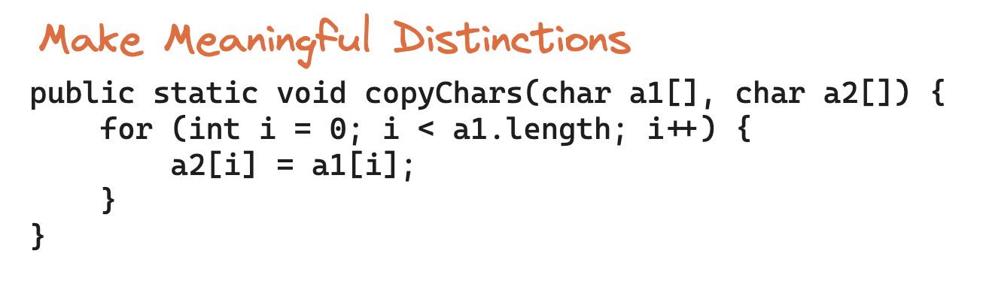
MEANINGFUL NAMES

Slide 13
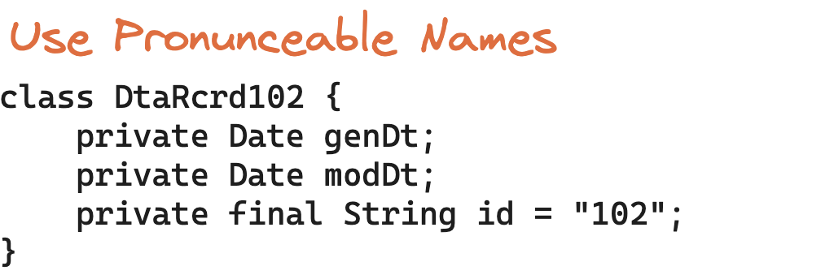
MEANINGFUL NAMES

Slide 14
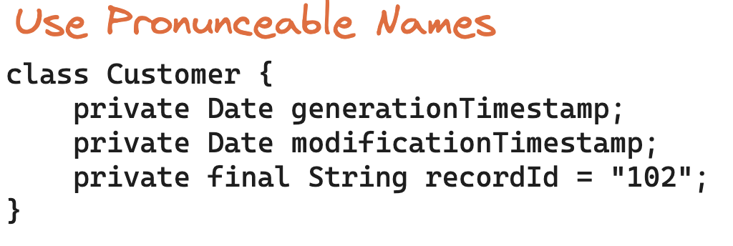
MEANINGFUL NAMES

Slide 15
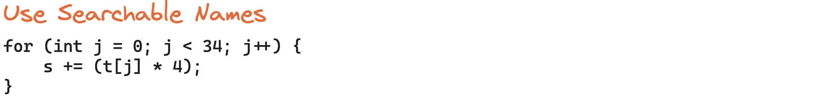
MEANINGFUL NAMES

Slide 16
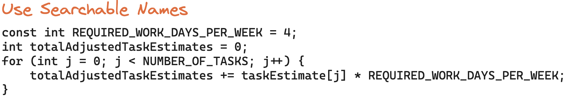
MEANINGFUL NAMES

Slide 17
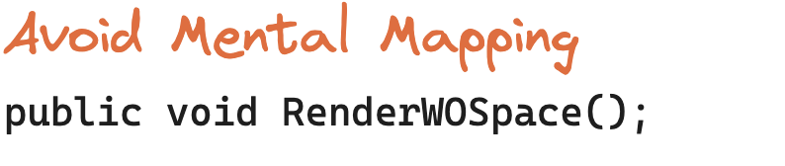
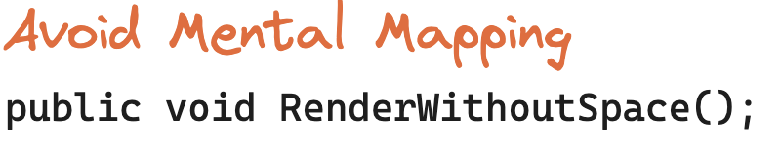

MEANINGFUL NAMES

Slide 18
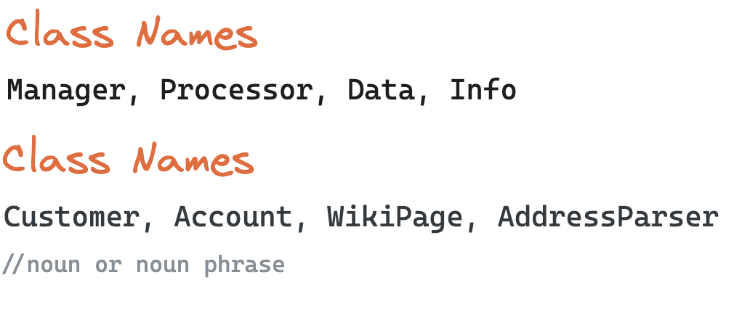
MEANINGFUL NAMES

Slide 19
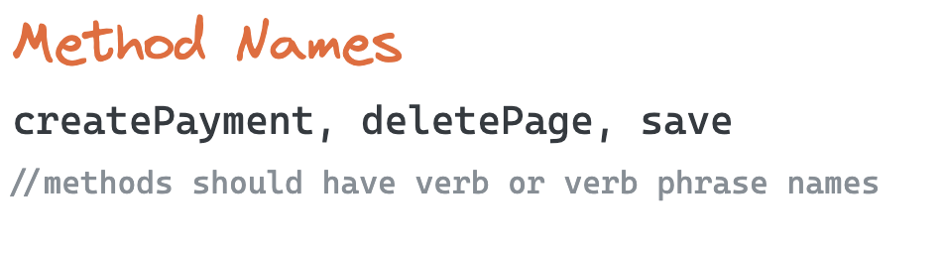
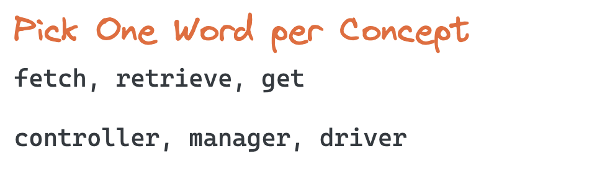
MEANINGFUL NAMES

Slide 20
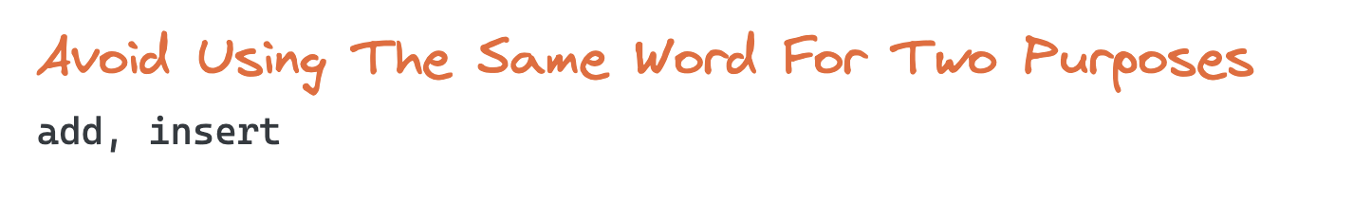
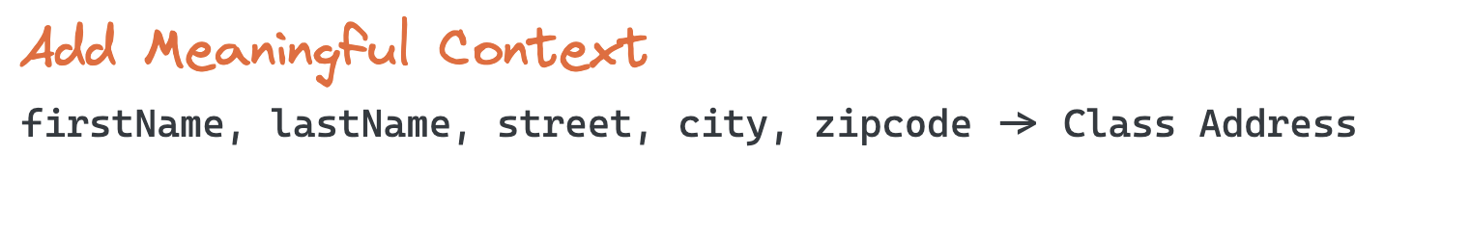
MEANINGFUL NAMES

Slide 21
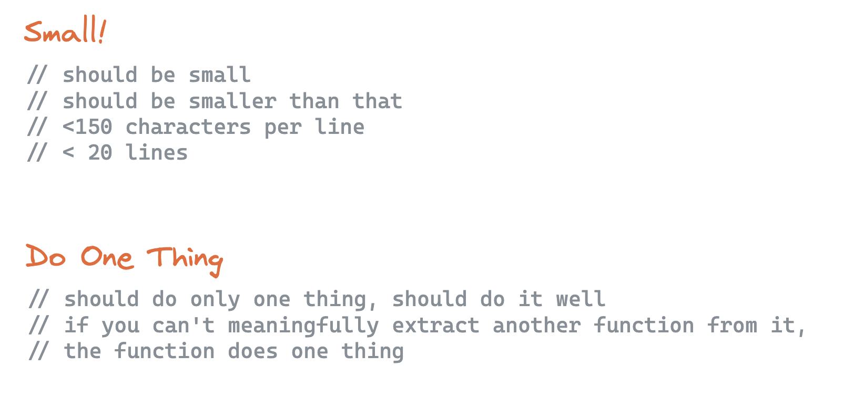
FUNCTIONS

Slide 22
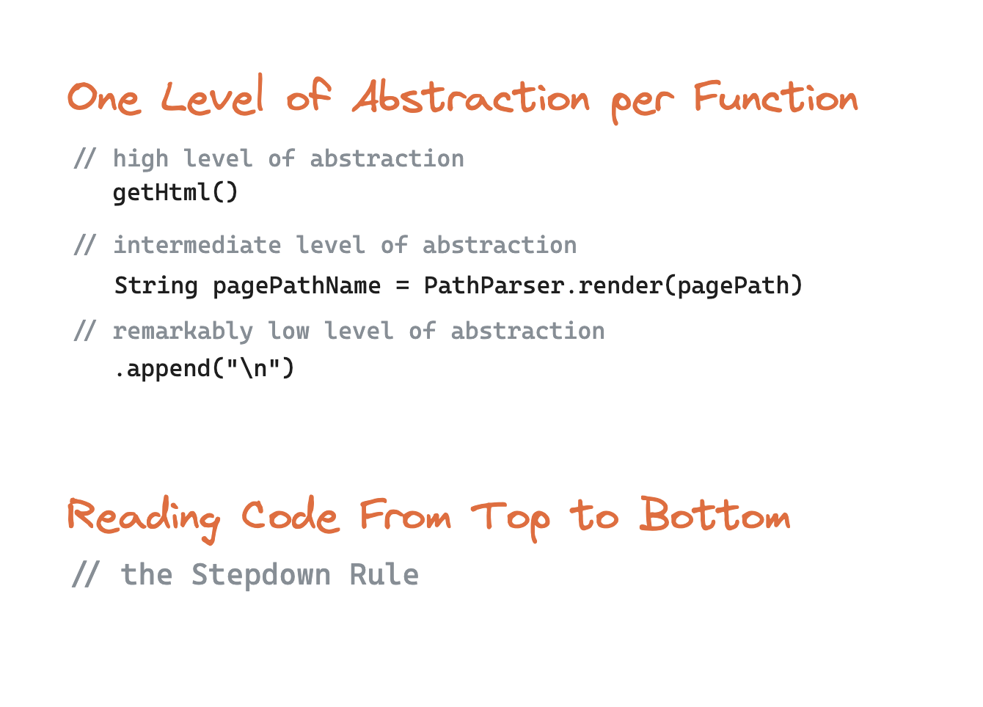
FUNCTIONS

Slide 23
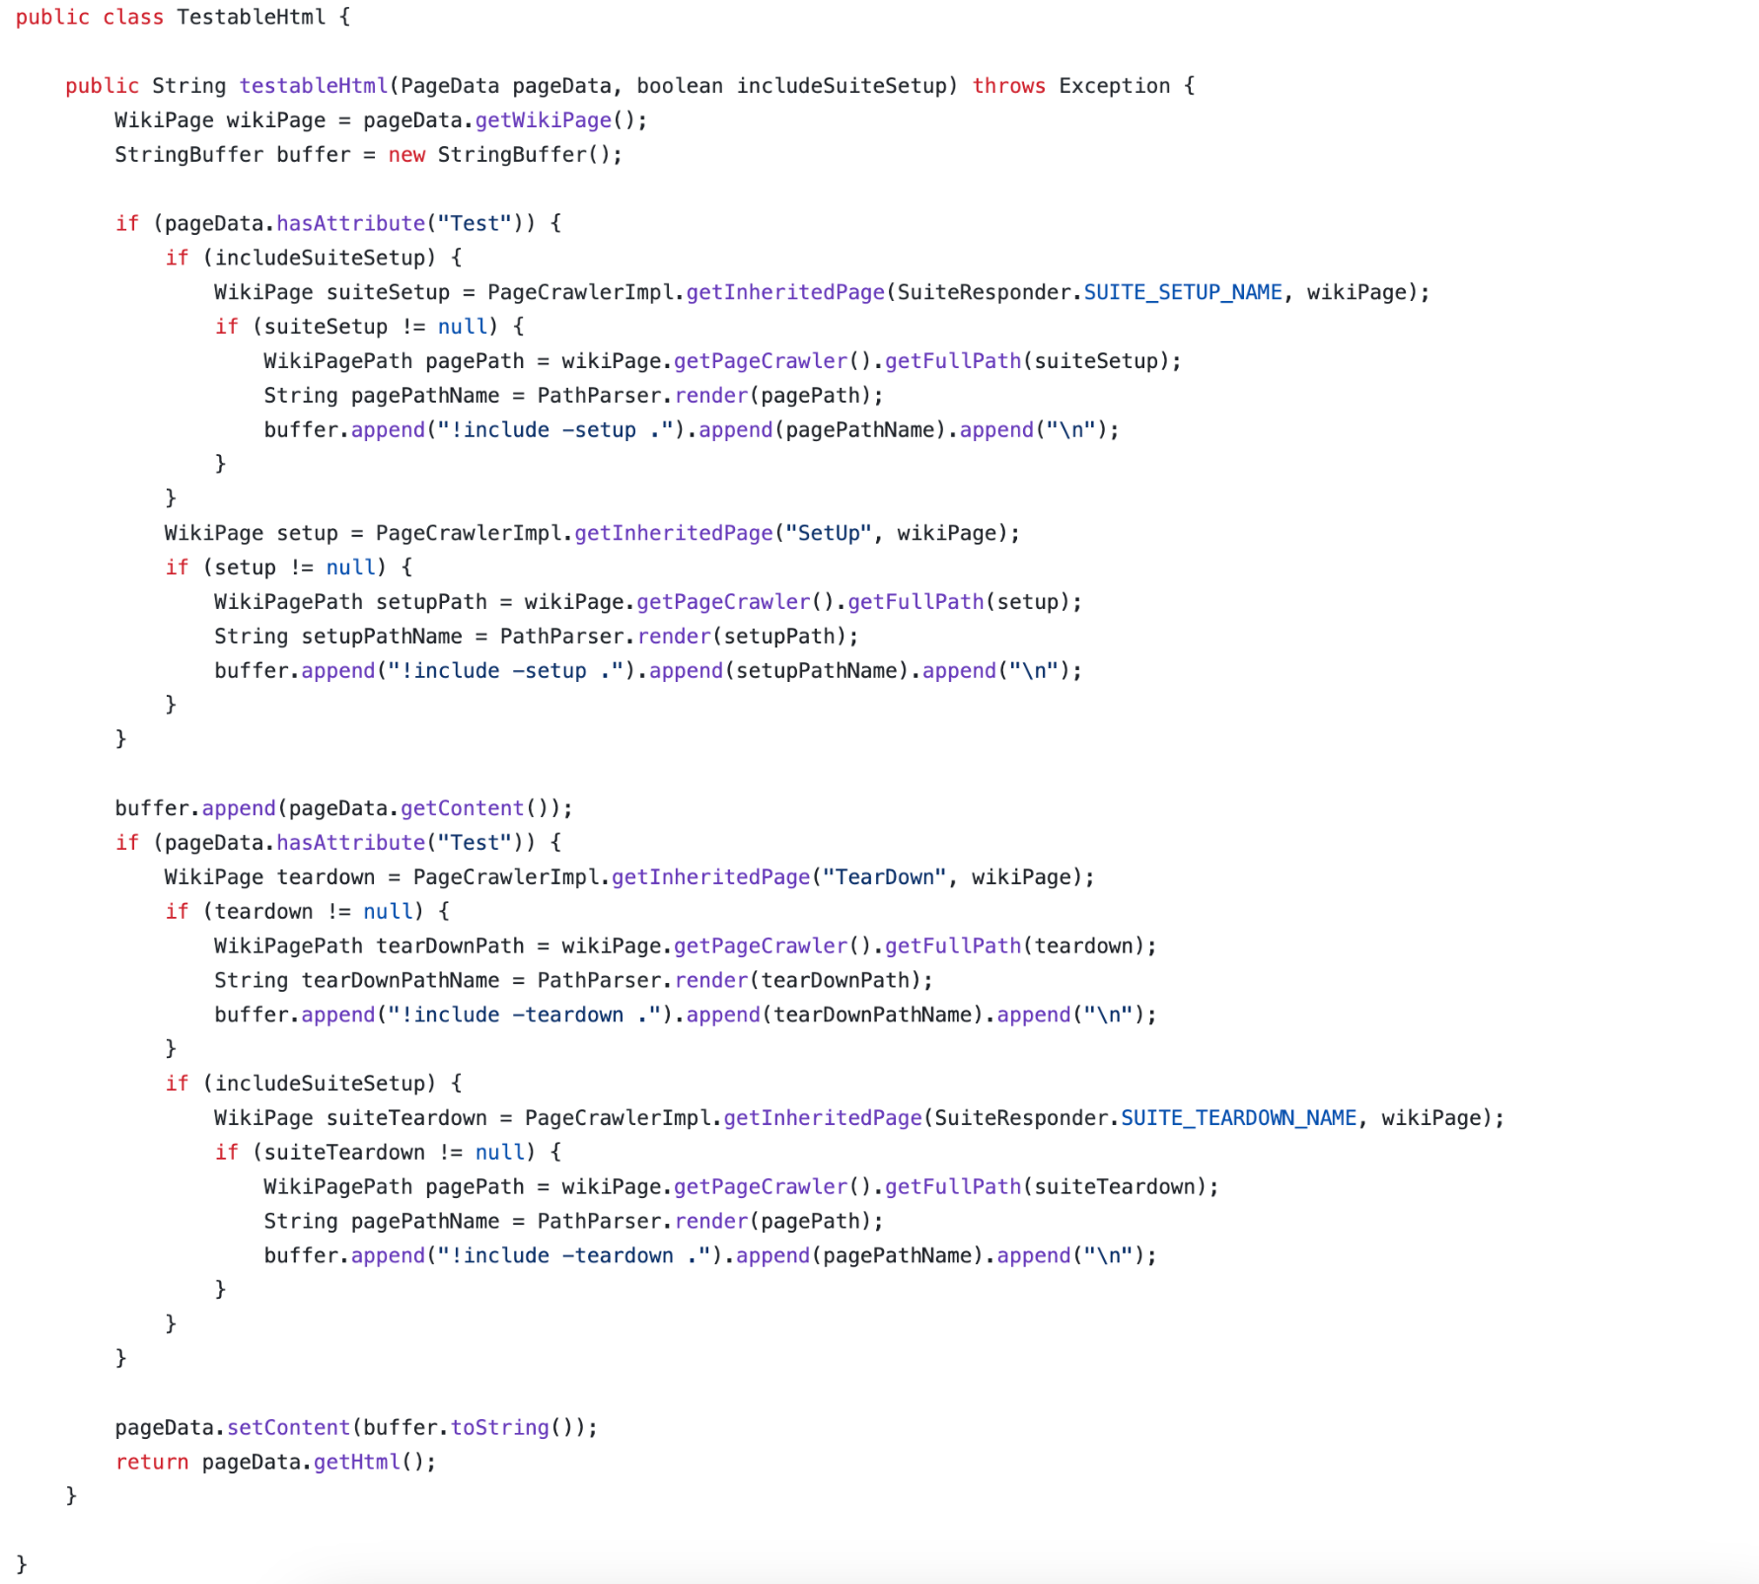

Slide 24
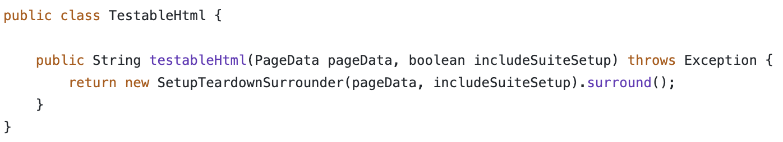
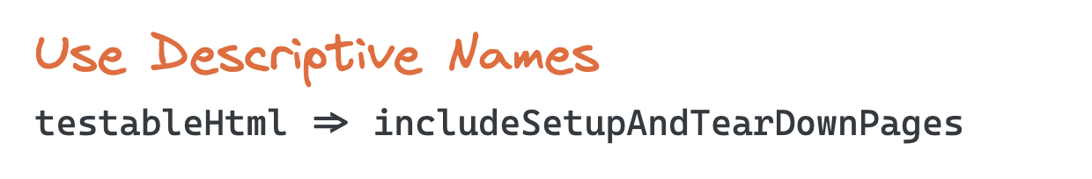
FUNCTIONS

Slide 25
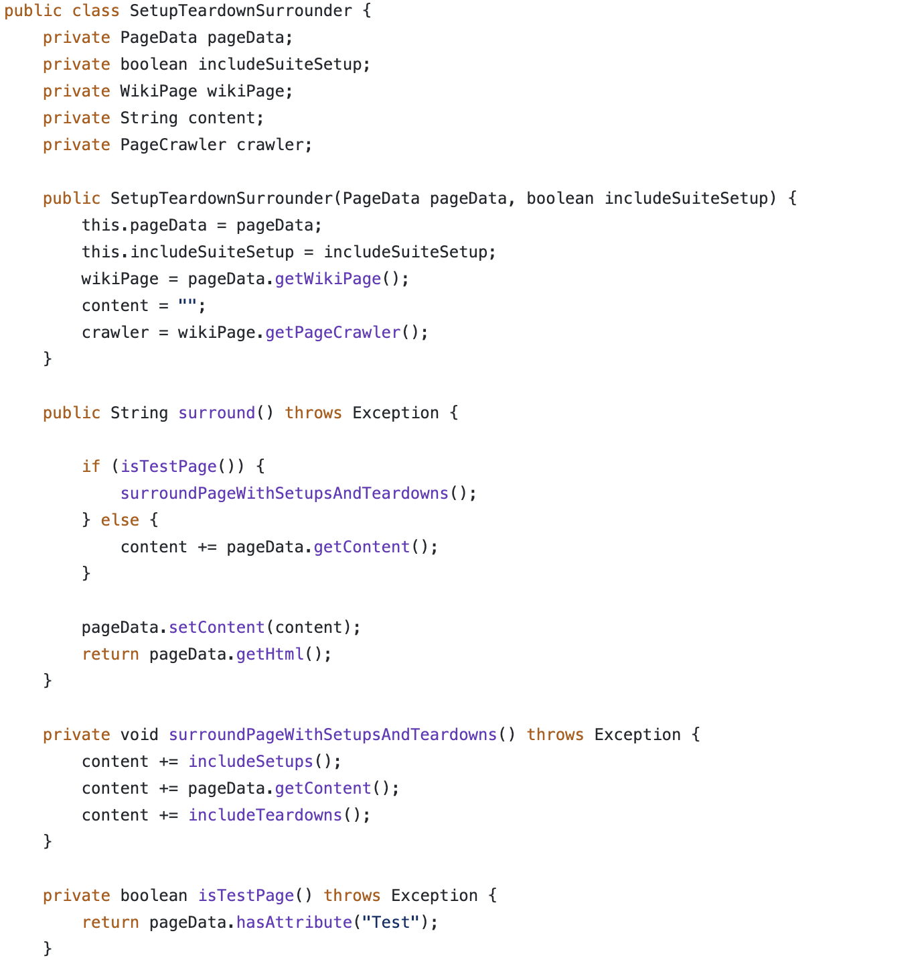
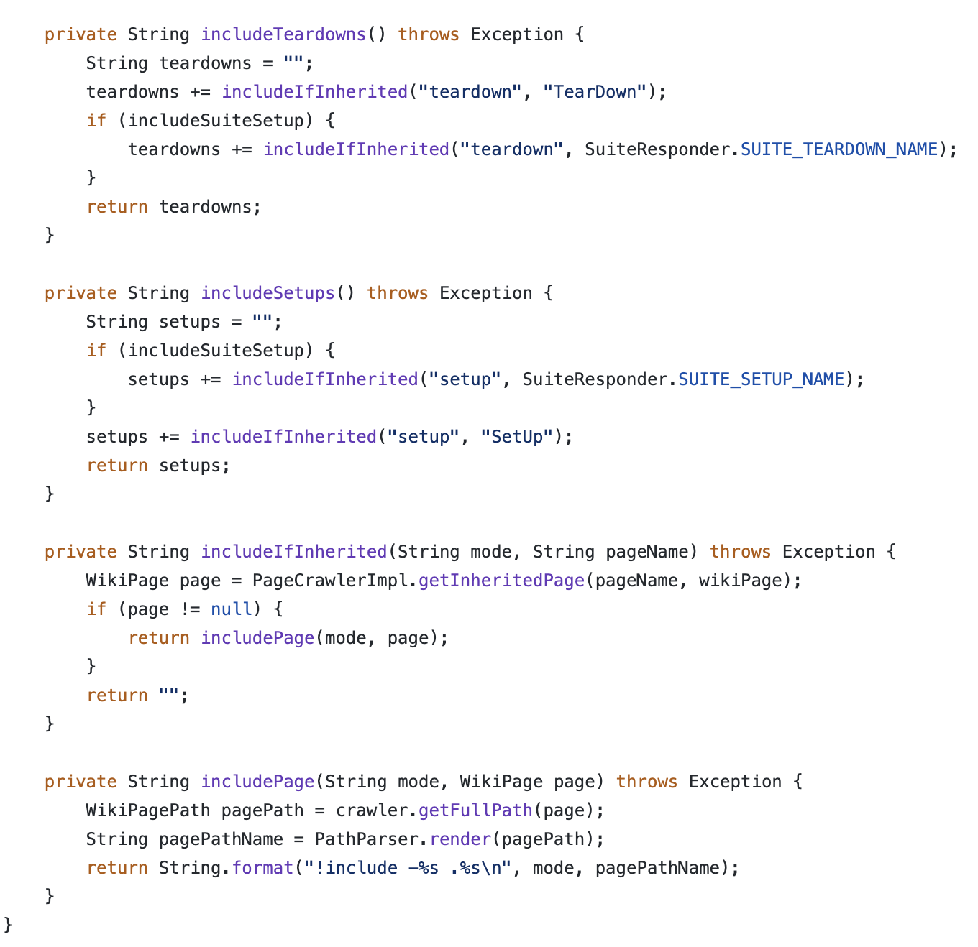

Slide 26
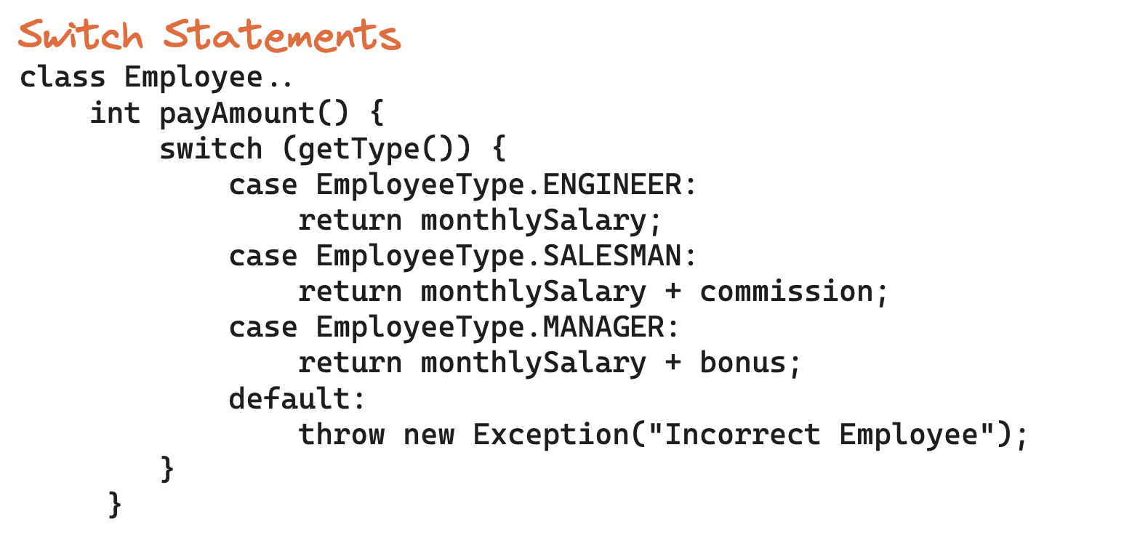
FUNCTIONS

Slide 27
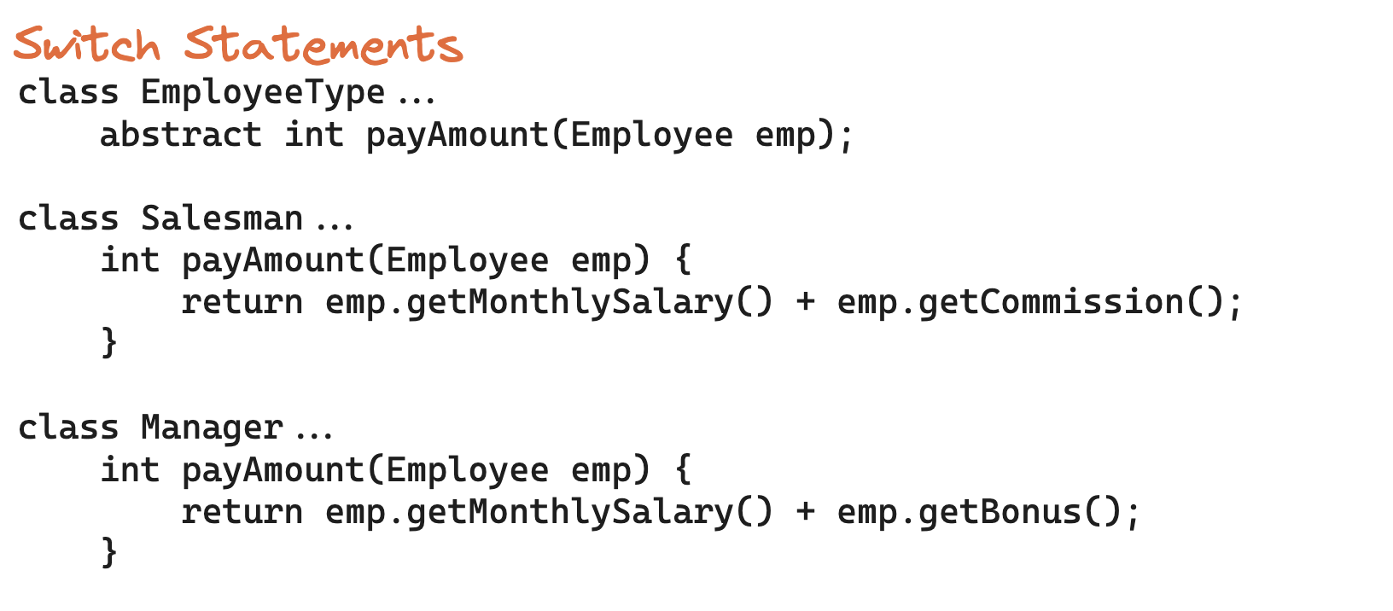
FUNCTIONS

Slide 28
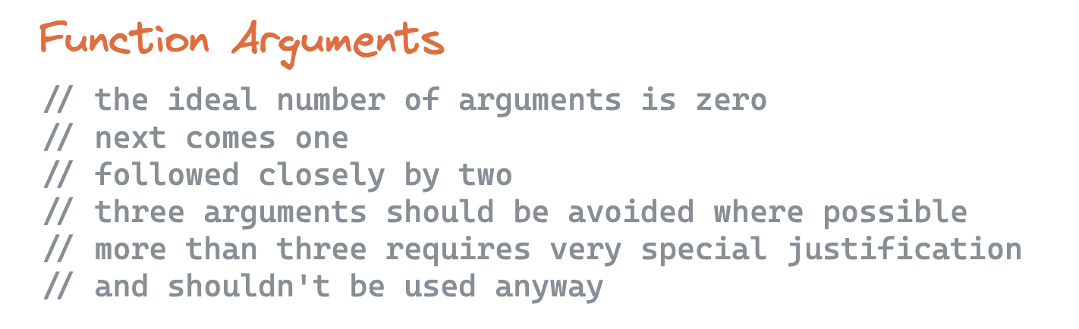
FUNCTIONS

Slide 29
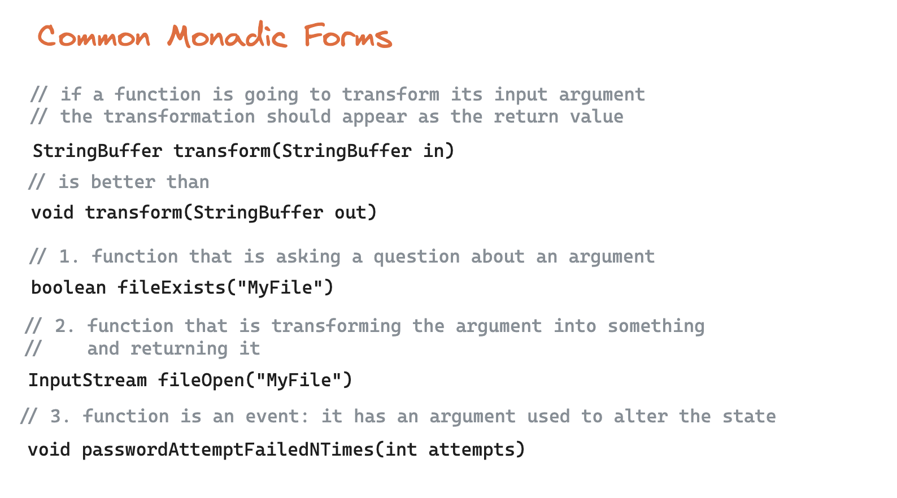
FUNCTIONS

Slide 30
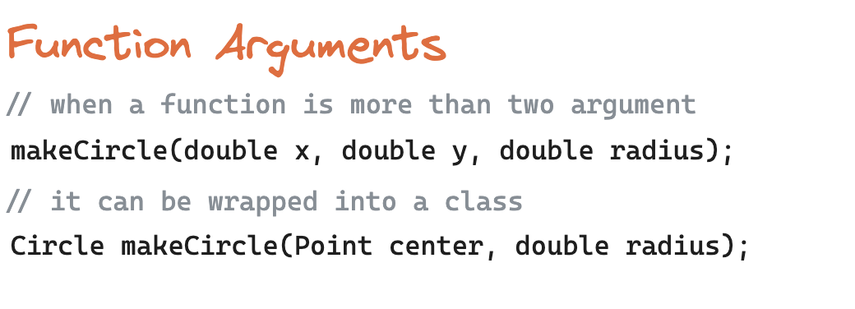
FUNCTIONS

Slide 31
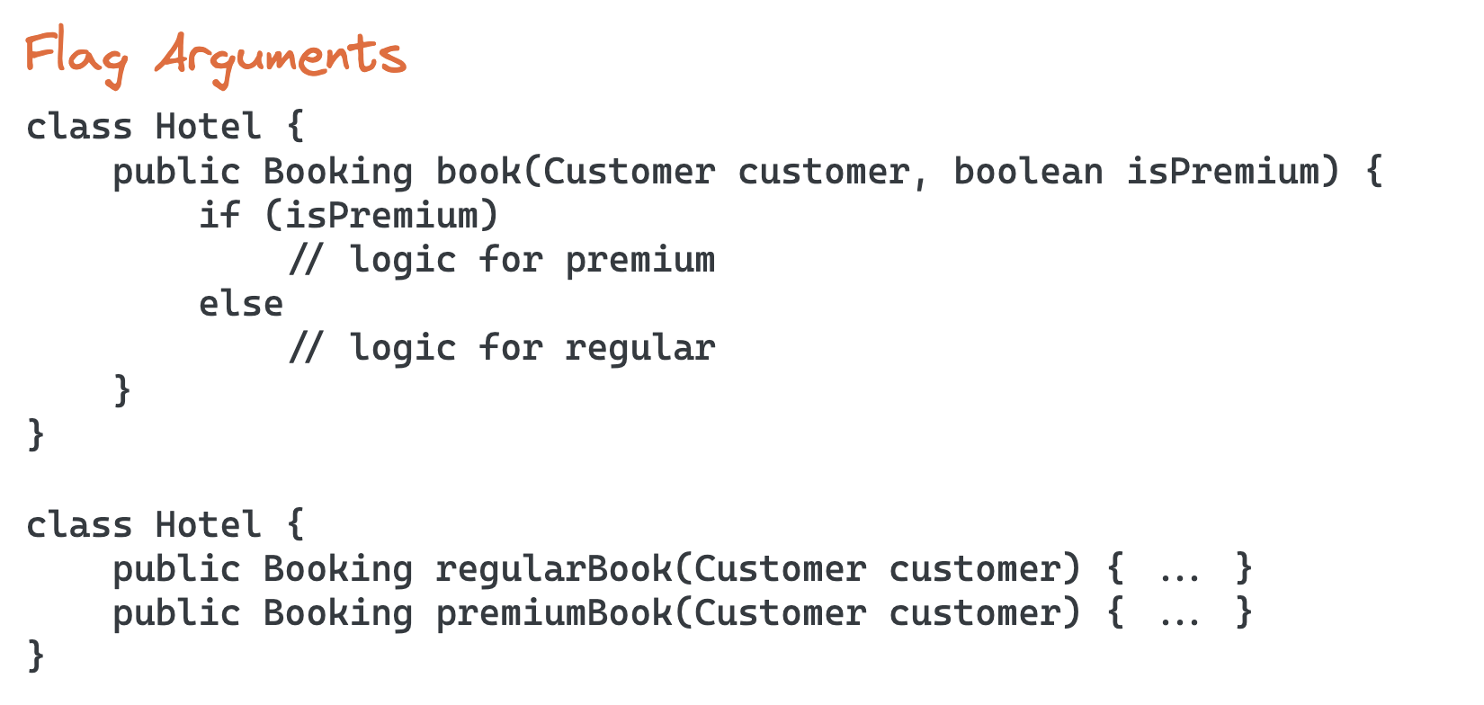
FUNCTIONS

Slide 32
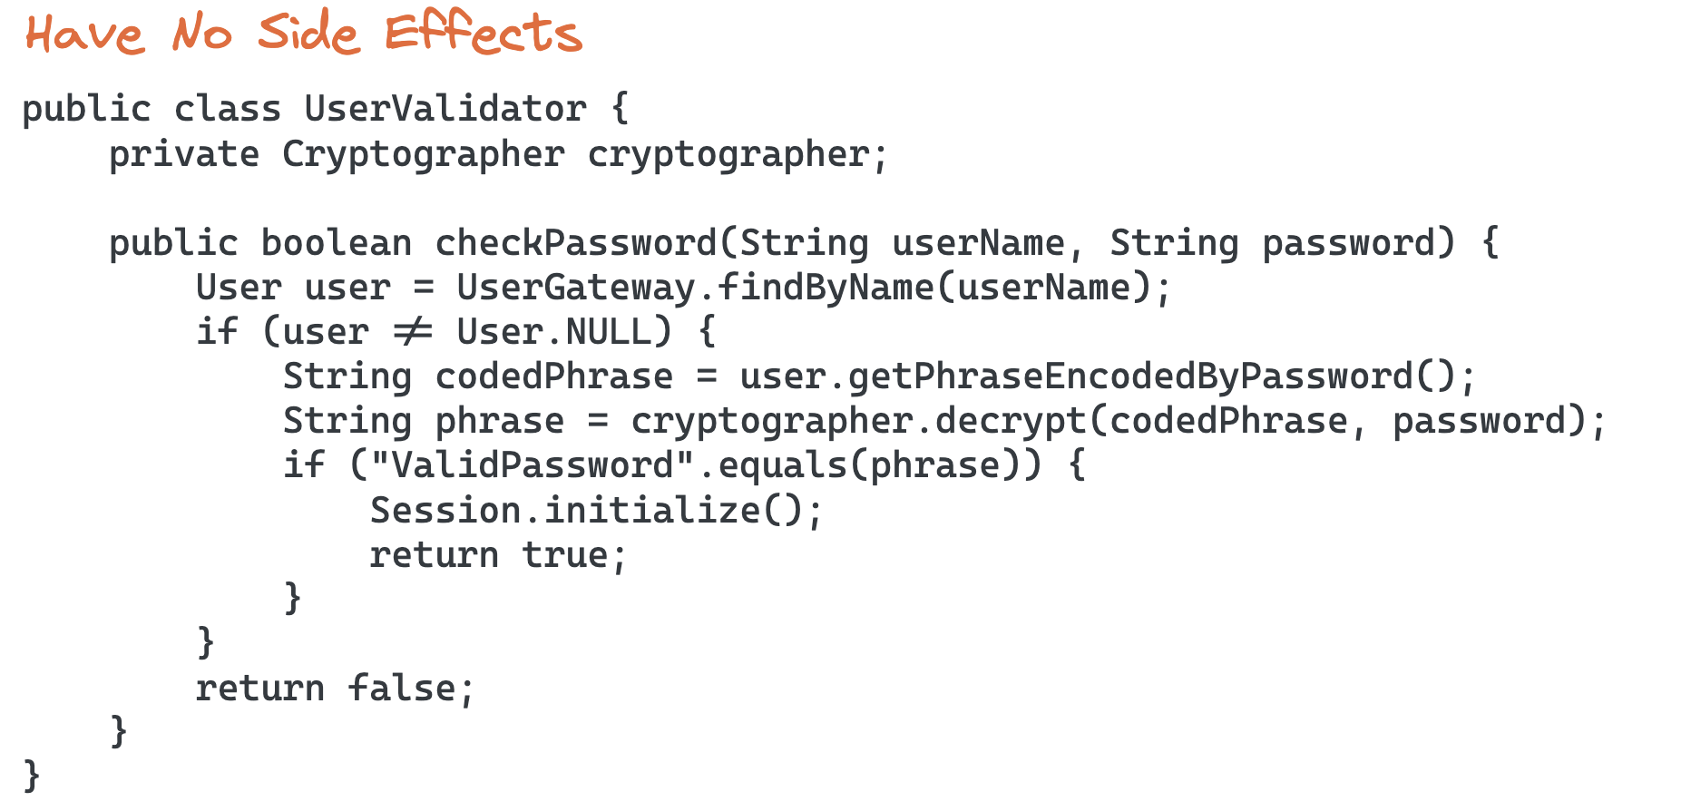
FUNCTIONS

Slide 33
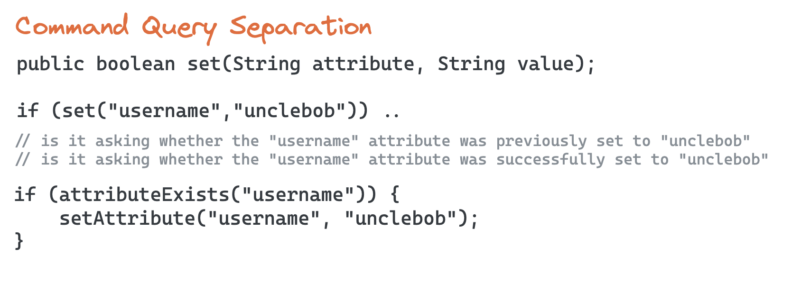
FUNCTIONS

Slide 34
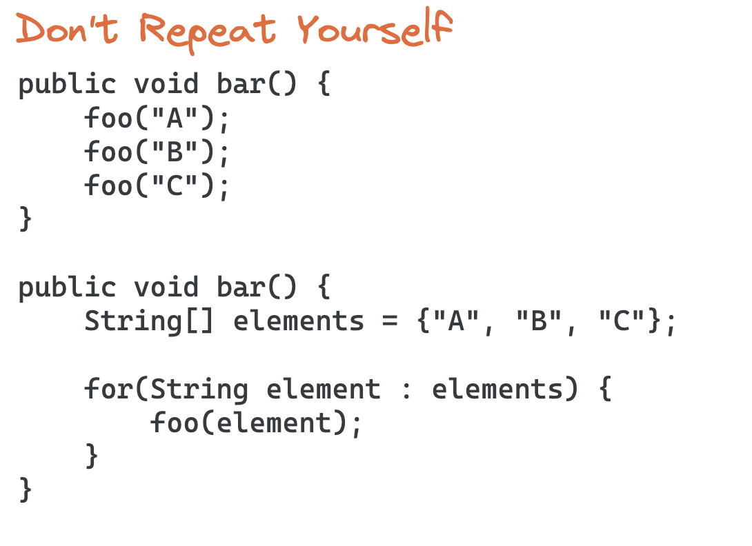
FUNCTIONS

Slide 35
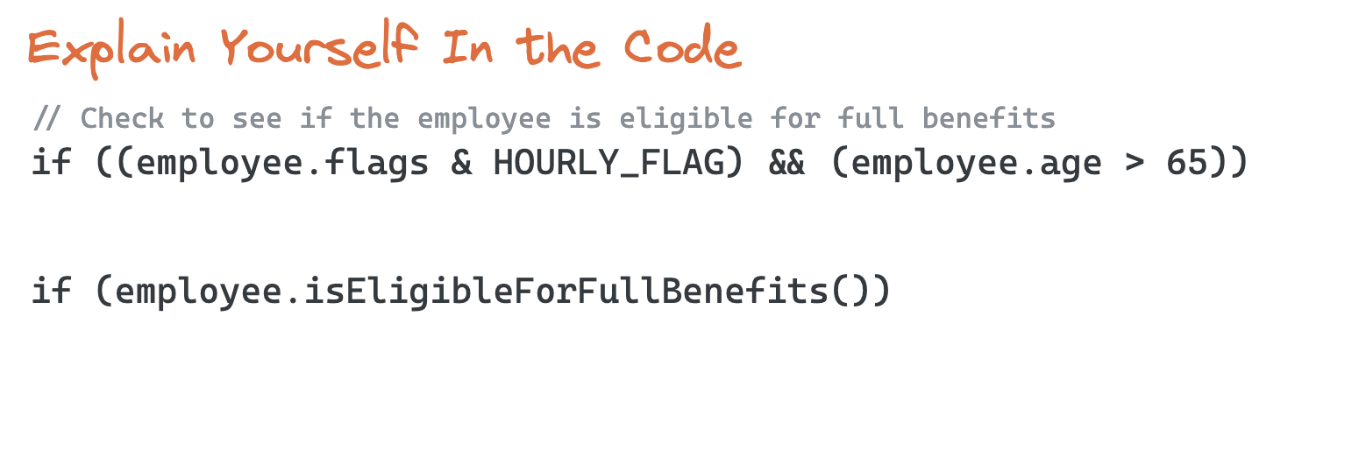
COMMENTS

Slide 36
Do’s
Dont’s
Explain yourself in code
Legal comments
Explanation of intent
Warning of consequences
TODO comments
API Documentation
Informative comments
//format matched kk:mm:ss EEE, MMM dd, yyyy
Pattern.compile(“\\dd*:\\d*:\\d* \\w*, \\w* \\d*, \\d*”);
Trying to cover up bad code with comments
Mumbling in comments is just an excuse for poor code
Redundant comments
Mandated comments such as javadoc for every function
Journal comments? We have git now
Position markers
Commented-out code
Too much information
Noise comments:
/*The day of the month. */
private int dayOfMonth;

Slide 37
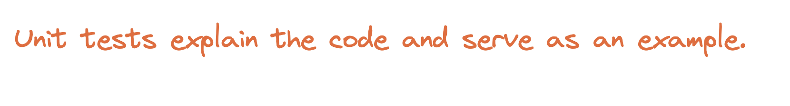
UNIT TESTS

Slide 38
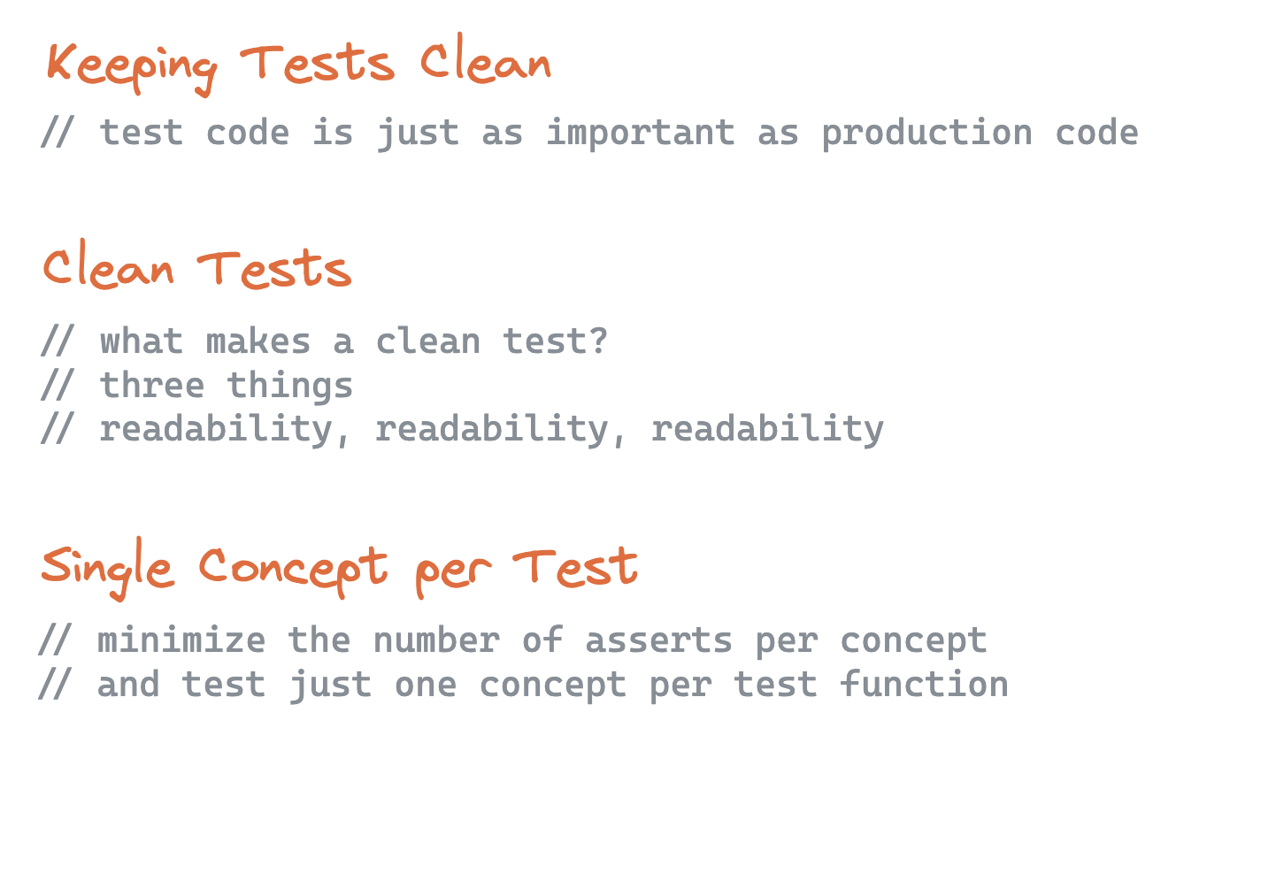
UNIT TESTS

Slide 39
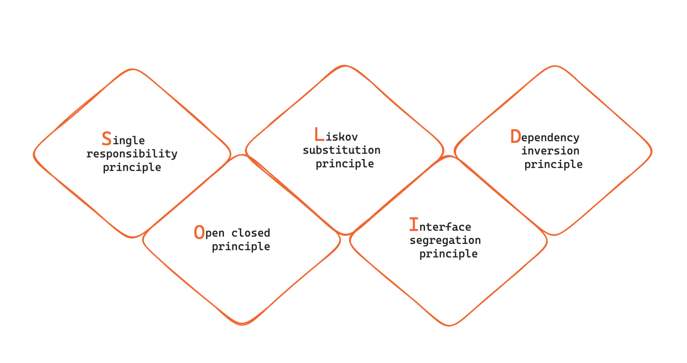
SOLID
Design principles encourage us to create more maintainable, understandable, and flexible software.

Slide 40
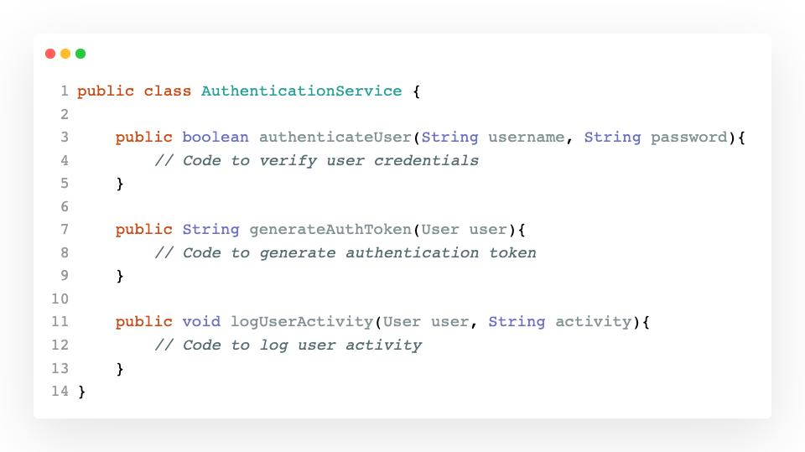
SOLID
single responsibility principle
Class should have one primary job to do and should change for only one reason – when that specific responsibility undergoes a modification.
Straightforward Testing: A class with one responsibility will have far fewer test cases.
Reduced Coupling: Less functionality in a single class will have fewer dependencies.
Enhanced Organization: Smaller, well-organized classes are easier to locate, understand, and maintain than monolithic ones.

Slide 41
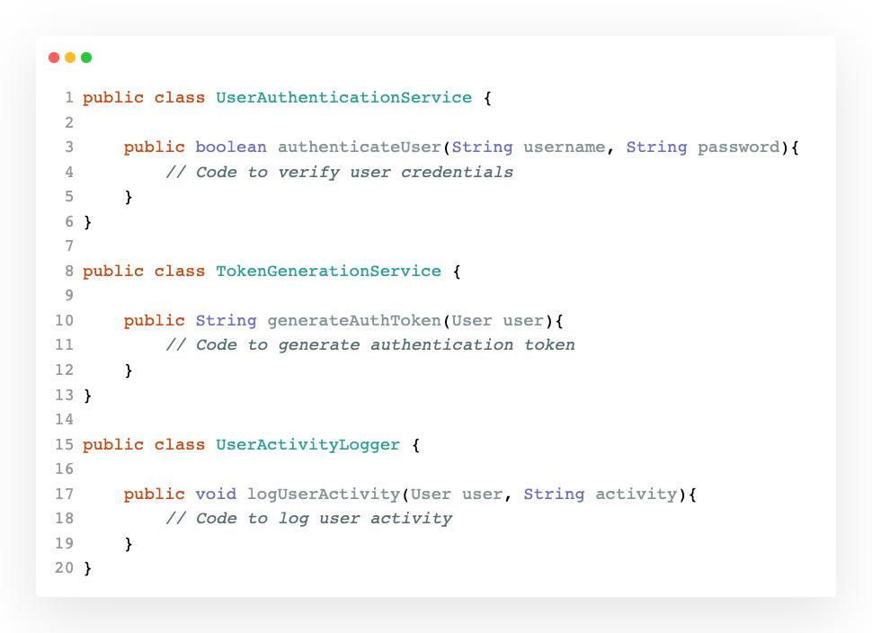
SOLID
single responsibility principle

Slide 42
SOLID
open closed principle
Classes should be open for extension but closed for modification.
In doing so, we stop ourselves from modifying existing code and causing
potential new bugs in an otherwise happy application.

Slide 43
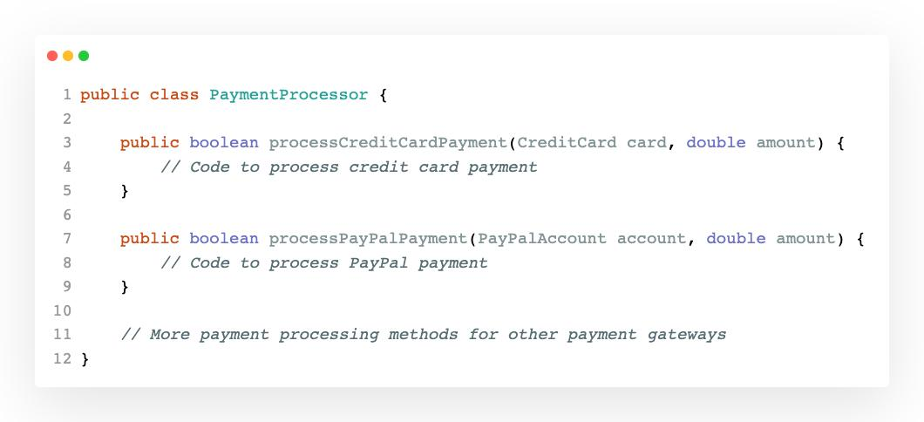
SOLID
open closed principle

Slide 44
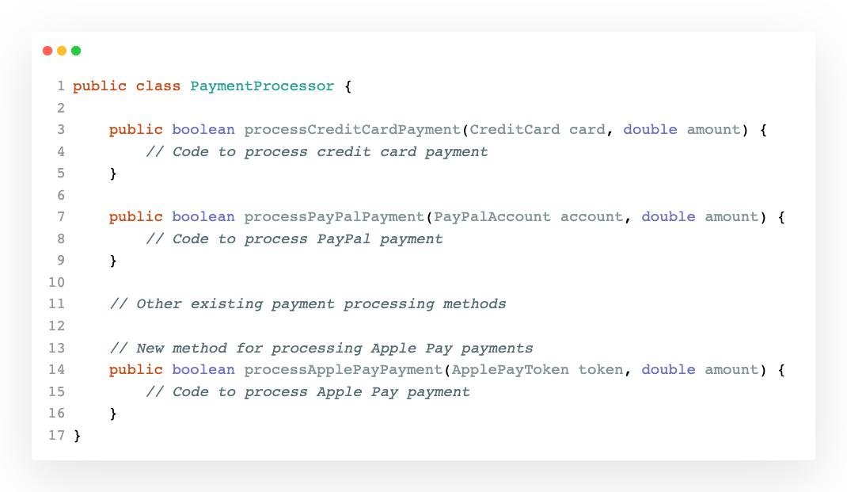
SOLID
open closed principle

Slide 45
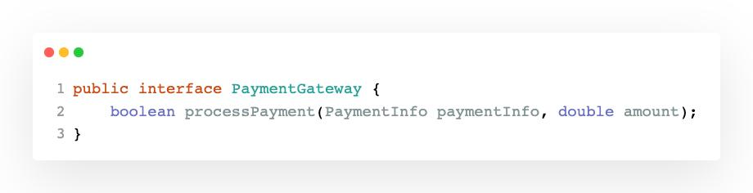
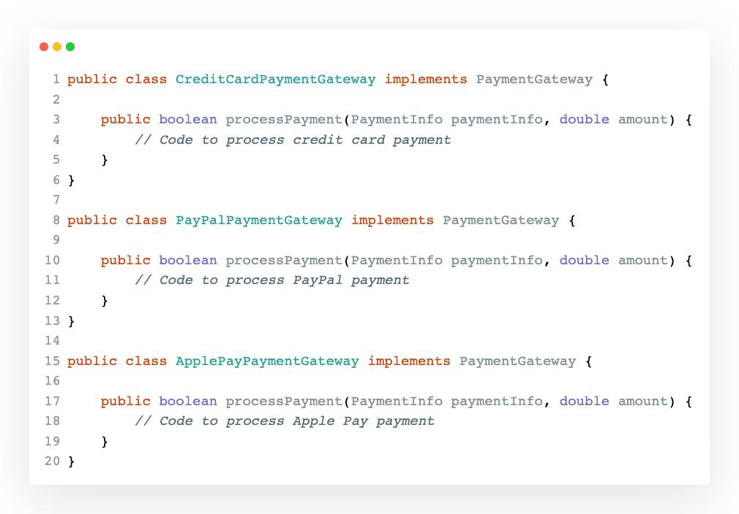
SOLID
open closed principle
By introducing this hierarchy of payment gateway classes, you adhere to the Open-Closed Principle.
You can easily extend your system to support new payment gateways by creating new classes without modifying the existing ones.
This approach makes your code more maintainable and flexible as your application evolves to support various payment methods.

Slide 46
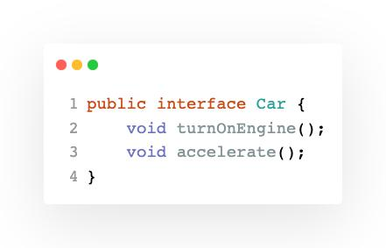
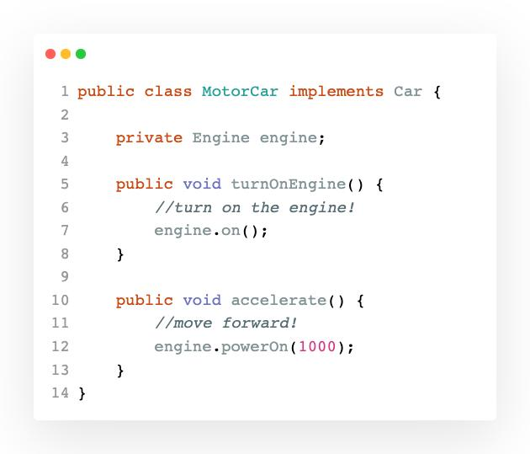
SOLID
liskov substitution principle
Objects of derived classes should be able to be used interchangeably with objects of their base classes without affecting the correctness of the program.
If MotorCar is a subtype of class Car, we should be able to replace MotorCar with Car without disrupting the behavior of our program.

Slide 47


SOLID
liskov substitution principle
One possible solution would be to rework our model into interfaces that take into account the engine-less state of our Car.

Slide 48


SOLID
interface segregation principle
Larger interfaces should be divided into smaller, more specific ones.
This ensures that implementing classes are only required to implement methods that are relevant to their specific functionality.
The MultimediaPlayer interface combines methods for both audio and video playback.
Each class is forced to implement both methods, even if it is only capable of handling one of them.

Slide 49


SOLID
interface segregation principle
Separate interfaces for audio and video player.
Implement related interface(s) for class.
Each class; SimpleAudioPlayer and SimpleVideoPlayer, implements the specific interface relevant to its functionality.
This adheres to the Interface Segregation Principle by avoiding unnecessary method implementations and ensuring that classes depend only on the methods they need.

Slide 50


SOLID
dependency inversion principle
The principle of dependency inversion refers to the decoupling of software modules. This way, instead of high-level modules depending on low-level modules, both will depend on abstractions.
The NotificationService class is tightly coupled to specific notification methods; email and SMS.
To add more notification methods in the future, we would have to modify this class, violating the Open-Closed Principle.
To apply the Dependency Inversion Principle and decouple the high-level module -NotificationService- from the low-level modules -NotificationMethods-, we can introduce an abstraction.

Slide 51


SOLID
dependency inversion principle
Now, we can create specific notification method classes that implement the interface:
Next, we modify the NotificationService class to depend on the NotificationProvider interface rather than concrete methods:

Slide 52

REFACTORING

Slide 53

REFACTORING
Two Distinct Activities
Adding functions and refactoring should not happen at the same time.
Goals
Enhance code readability
Reduce complexity
Improve extensibility
Enhance performance
Improve maintainability
Rule of Three
You do something the first time
You do similar thing again with regret
On the third time - start refactoring
three strikes and you refactor

Slide 54


Slide 55
TripService KATA
We have a social media application where people can see each others trips.
BUSINESS RULES
You must be logged in to see yours or any other trips.
To see other’s trips you have to be friends with them.
REFACTORING APPROACH
We don’t want to change behaviour, we want to increase readability. First make sure to have fully covering tests.
Allow only IDE generated refactoring changes.
https://github.com/sandromancuso/trip-service-kata/tree/master/java/trip-service-kata

Slide 56

THANK YOU

